Slide 1



Air Force Institute of Technology
NENG 791 – Proliferation of Weapons of Mass Destruction
Safeguards: Domestic and International
Lt Col Fee
E d u c a t i n g t h e W o r l d ’s B e s t M i l i t a r y
Notes:
These slides were taken from a presentation developed primarily by Dr. David Chichester. They were developed through a multi-institution collaboration with funding provided by the Global Threat Reduction Initiative specifically for export to other academic institutions to improve the nuclear security instruction provided as part of their undergraduate and graduate nuclear education programs.

Slide 2
Safeguards
What are nuclear safeguards?
What are domestic safeguards?
What are international safeguards?
Notes:
(1) Nuclear safeguards is an elaborate arrangement of formal and informal systems, both political and technical in nature, that has evolved over the last 65 years to address the need to secure, track, and inventory fissionable material and other radioactive material.
(2) Individual countries develop and employ domestic safeguards programs to protect their own interests, guarding fissionable material from theft or sabotage.
(3) Groups of countries work together to develop, employ, and enforce international safeguards programs, led foremost by the IAEA and within the framework of the Nuclear Nonproliferation Treaty, with the goals of preventing the unregulated spread of nuclear material and building confidence among nations that undeclared nuclear weapon related activities are not underway.

Slide 3
Safe, Secure, and Safeguarded Nuclear Energy
What are the three major threats?
What mitigation is involved for each of the threats?
Notes:
(1) Natural Hazards and accidents (equipment, system, and human failures)
Safety Systems—risk analysis
(2) Theft, sabotage, terrorism, cyber-attack, etc. against the owner / operator / state
Domestic Safeguards—physical protection and material control and accountancy
(3) Proliferation via material diversion, facility misuse, clandestine activities, etc. by the owner / operator / state
International Safeguards—International Treaties & Agreements, and the International Atomic Energy Agency (IAEA)

Slide 4
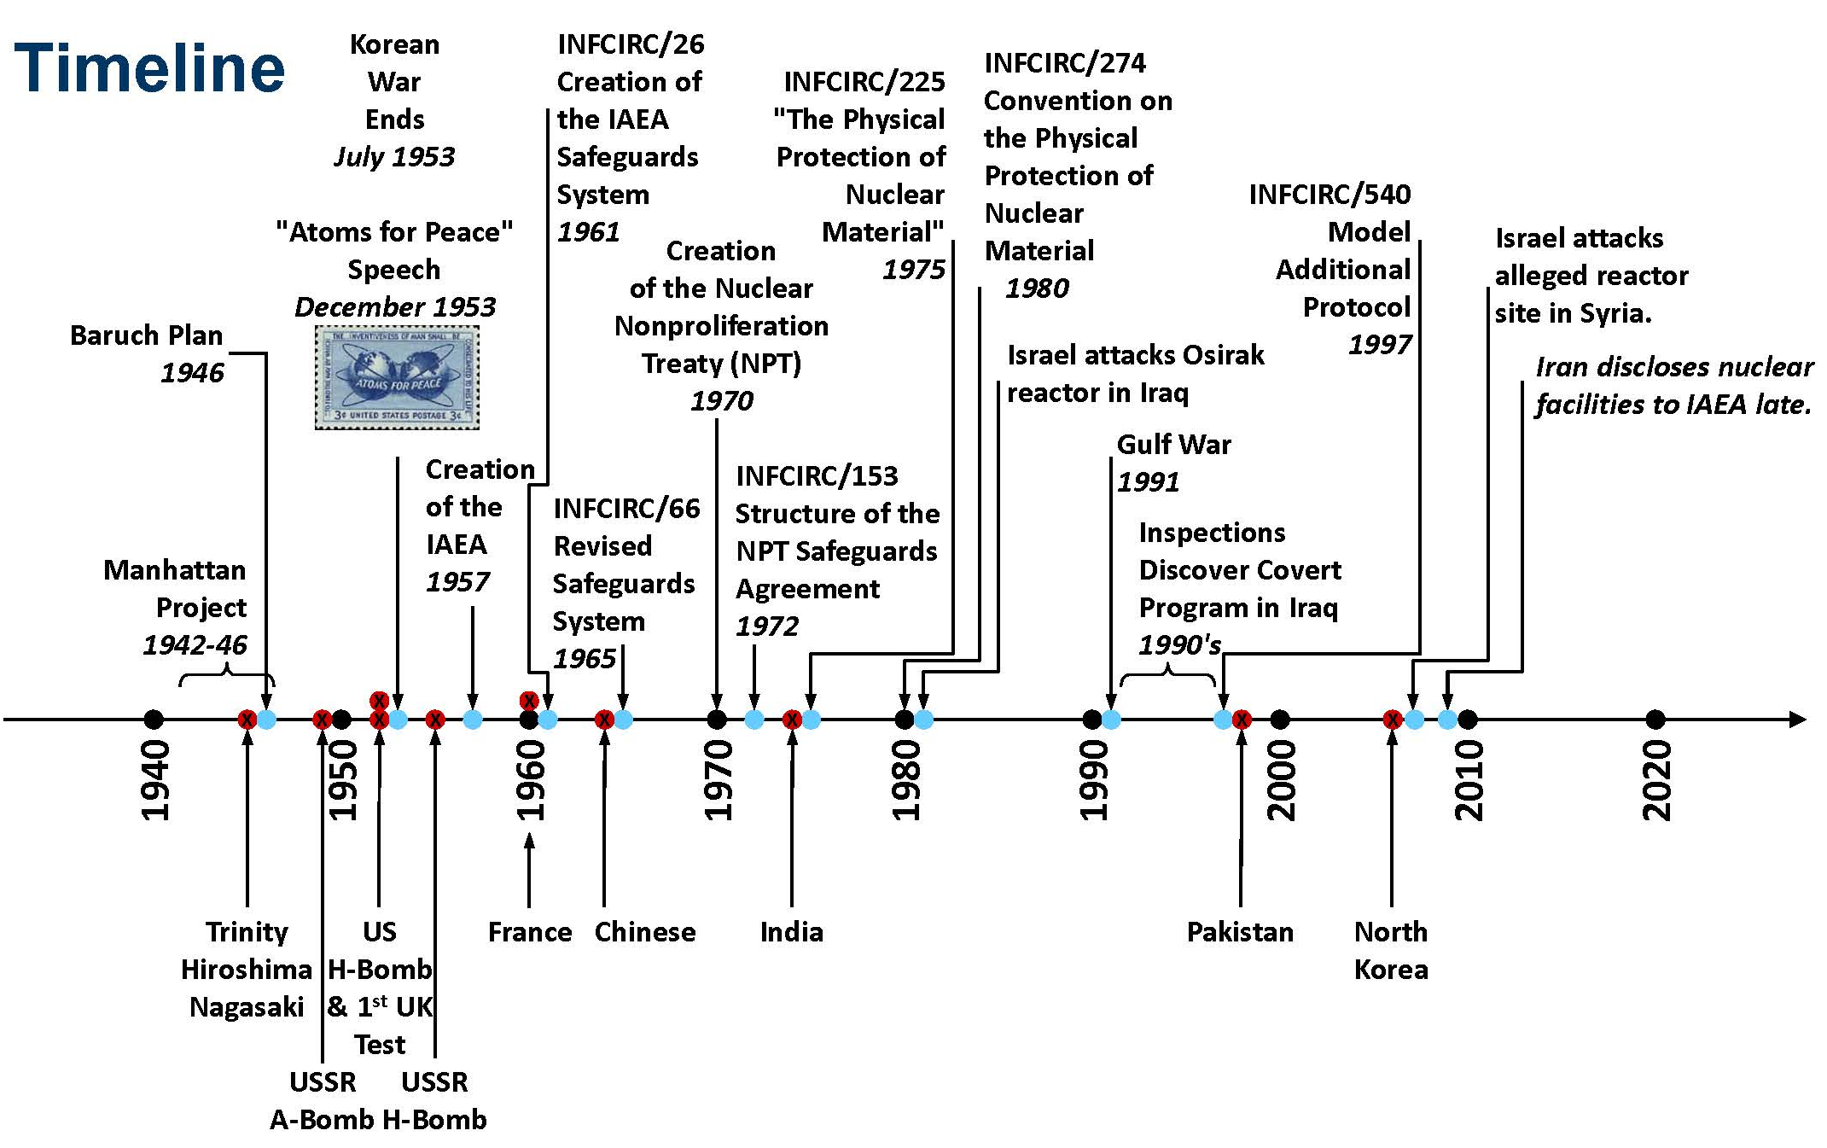

Slide 5
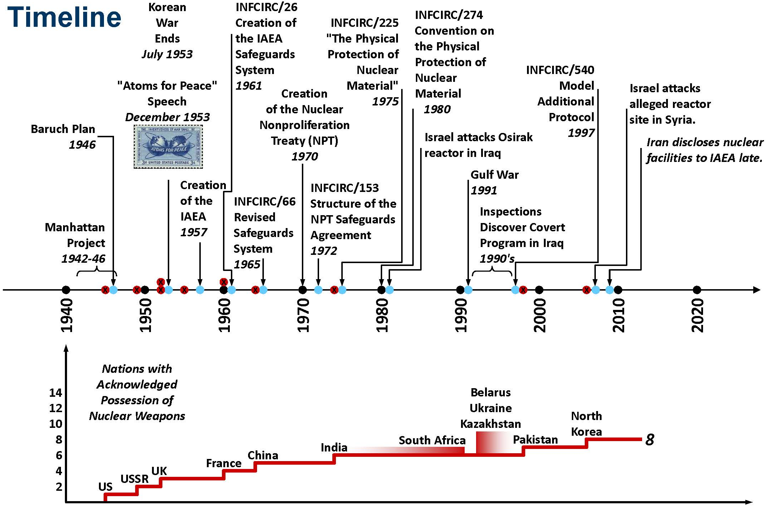

Slide 6
Treaties & Agreements—Arms Control & Nonproliferation
1957—Treaty of Rome (established EURATOM)
1961—The Antartic Treaty
1963—Hot Line Agreement (The “red” phone)
1963—Limited Test Ban Treaty—prohibits nuclear explosions in the atmosphere, in outer space, and under water
1964—African Nuclear Weapon Free Zone Treaty
1967—Outer Space Treaty
1969-72—Strategic Arms Limitation Talks (SALT)—results in ABM treaty and Interim Agreement on the Limitation of Strategic Offensive Arms
1970—Nuclear Nonproliferation Treaty
1971—Accidents Measures Agreement—maintain and improve safeguards, notification of unusual risks, notification of missile launch

Slide 7
Treaties & Agreements—Arms Control & Nonproliferation
1972—Anti-Ballistic Missile Treaty
1972—Interim Agreement—Limitation of Strategic Offensive Arms
1972—Seabed Arms Control Traty
1972-79—Strategic Arms Limitation Talks (SALT II)—resulted in START treaty
1973—Prevention of Nuclear War Agreement
1980—US Agreement to Apply IAEA Safeguards in the US
1985—South Pacific Nuclear Free Zone Treaty
1987—Missile Technology Control Regime
1987—Convention on the Physical Protection of Nuclear Materials
1987—Agreement to establish Nuclear Risk Reduction Centers

Slide 8
Treaties & Agreements—Arms Control & Nonproliferation
1988—Ballistic Missile Launch Notification Agreement
1988—Intermediate-Range Nuclear Forces Treaty—required destruction of ground-launched ballistic and cruise missiles with ranges between 500-5500 km
1989—Latin American Nuclear Free Zone Treaty
1990—Agreement between Brazil and Argentina for the Exclusively Peaceful Use of Nuclear Energy (ABACC)
1990—Peaceful Nuclear Explosions Treaty (started in 1974)
1990—Threshold Test Ban Treaty (150kt) (started in 1974)
1992—Treaty on Conventional Armed Forces in Europe
1993—Strategic Arms Reduction Treaty (START II) (did not enter into force)
1994—Strategic Arms Reduction Treaty (START I) (signed in 1991)

Slide 9
Treaties & Agreements—Arms Control & Nonproliferation
1997—Comprehensive Nuclear Test-Ban Treaty (not ratified by Congress)
2000—Agreement for the Exchange of Data from Early Warning Systems and Notification of Missile Launches
2002—Open Skies Treaty
2003—Strategic Offensive Reductions Treaty (SORT)

Slide 10
IAEA: Domestic Safeguards
The objectives of the State's physical protection system should be:
(a) To establish conditions which would minimize the possibilities for unauthorized removal of nuclear material and/or for sabotage; and
(b) To provide information and technical assistance in support of rapid and comprehensive measures by the State to locate and recover missing nuclear material and to cooperate with safety authorities in minimizing the radiological consequences of sabotage.
Notes:
The Physical Protection of Nuclear Material and Nuclear Facilities (IAEA INFCIRC/225/Rev.4) https://www.iaea.org/sites/default/files/infcirc225r4c.pdf

Slide 11
IAEA: Domestic Safeguards
3.2. The objectives of the International Atomic Energy Agency (Agency) are:
(a) To provide a set of recommendations on requirements for the physical protection of nuclear material in use and storage and during transport and of nuclear facilities. The recommendations are provided for consideration by the competent authorities in the States. Such recommendations provide guidance but are not mandatory upon a State and do not infringe the sovereign rights of States; and
(b) To be in a position to give advice to States' authorities in respect of their physical protection systems at the request of the State. The intensity and the form of assistance required are, however, matters to be agreed upon between the State and the Agency.
It should be noted that the Agency has no responsibility either for the provision of a State's physical protection system or for the supervision, control or implementation of such a system. Assistance by the Agency will be provided only when so requested by the State.
Notes:
The Physical Protection of Nuclear Material and Nuclear Facilities (IAEA INFCIRC/225/Rev.4) https://www.iaea.org/sites/default/files/infcirc225r4c.pdf

Slide 12
NRC: Domestic Safeguards
The NRC's domestic safeguards program is aimed at ensuring that special nuclear material within the United States is not stolen or otherwise diverted from civilian facilities for possible use in clandestine fissile explosives and does not pose an unreasonable risk owing to radiological sabotage. The users of the special nuclear and certain quantities of byproduct material apply safeguards to protect against sabotage, theft, and diversion, including
Physical protection of facilities and/or special nuclear material at both fixed sites and during transportation and
Material control and accounting for special nuclear material.
In order to determine how much physical protection is enough, the NRC has a threat assessment program to maintain awareness of the capabilities of potential adversaries and threats to facilities, material, and activities.
Notes:
Taken from the NRC website: http://www.nrc.gov/security/domestic.html
Domestic safeguards are a part of the nation’s internal security activities
The key parts of domestic safeguards activities are: Physical Protection and Material Control and Accounting

Slide 13
NRC Domestic Safeguards (10CFR1 Parts 1-199)
Physical Protection
NUREG/BR-0252 Users Guide to Physical Protection Documents
NUREG-0908 Acceptance Criteria for the Evaluation of Power Reactor Security Plans
NUREG-1322 Acceptance Criteria for the Evaluation of Category I Fuel Cycle Facility Physical Security Plans
NUREG-1619 Standard Review Plan for Physical Protection Plans for the Independent Storage of Spent Fuel and High-Level Radioactive Waste
Material Control & Accounting
NUREG-1280 Category I SNM—Standard Format and Content Acceptance Criteria for the Material Control and Accounting Reform Amendment
NUREG-1065 Category III SNM—Acceptable Standard Format and Content for the Fundamental Nuclear Material Control Plan Required for LEU facilities
ANSI N15.8-2009 Methods of Nuclear Material Control – Material Control Systems – SNM Control and Accounting Systems for Nuclear Power Plants
Cyber Security
US NRC Regulatory Guide 5.71 Cyber Security Programs for Nuclear Facilities

Slide 14
NRC Domestic Safeguards (10CFR1 Parts 1-199)
NRC's regulations are found in Chapter I of Title 10, "Energy," of the Code of Federal Regulations (CFR). Chapter I is divided into Parts 1 through 199. The following regulations are most applicable to safeguards:
Part 11 - Criteria and Procedures for Determining Eligibility for Access to or Control Over Special Nuclear Material
Part 25 - Access Authorization for Licensee Personnel
Part 26 - Fitness for Duty
Part 37 - Physical Protection of Category 1 and Category 2 Quantities of Radioactive Material
Part 70.51 - Material balance, inventory, and records requirements
Part 73 - Physical Protection of Plants and Materials
Part 74 - Material Control and Accounting of Special Nuclear Material
Part 76 - Certification of Gaseous Diffusion Plants
Part 95 - Facility Security Clearance and Safeguards of National Security Information and Restricted Data

Slide 15
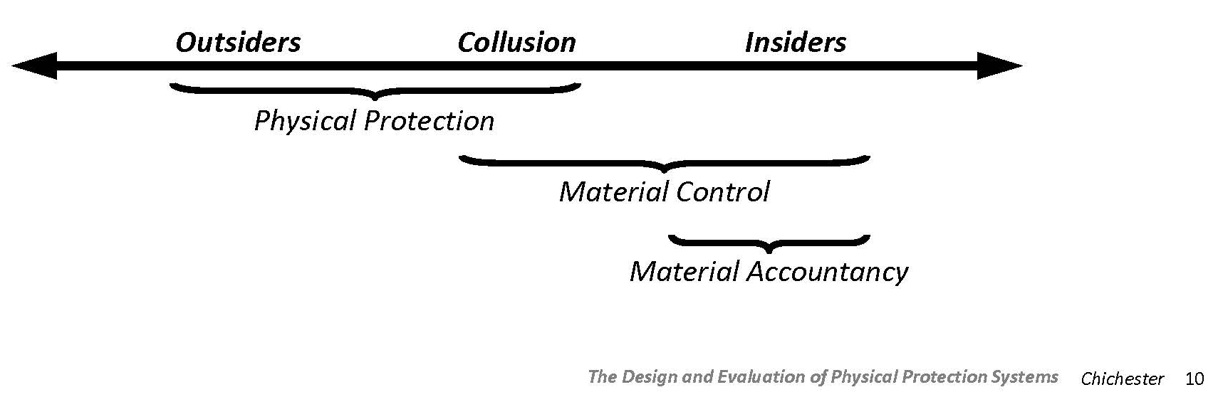
Key Challenges for Domestic Safeguards
Detecting and Identifying the Threat? Who are they?
Why are insiders the most commonly encountered threat?
Which protection systems are more or less important?
Notes:
Detecting and Identifying the Threat. Who are they?
Outsiders: thieves, terrorists, hackers…
Insiders: employees, contractors, …
Why are insiders the most commonly encountered threat?
Insiders present the most commonly encountered threat
Knowledge of operations and security plans
Unescorted access
In broad terms, 41% of crimes committed against assets are committed by guards!
Which protection systems are more or less important?
Depending upon the situation different protection systems are more or less important

Slide 16
Physical Protection
What is a physical protection system (PPS)?
What are the three parts of any PPS?
What are some of the components / descriptors of each of the three parts of the PPS?
Notes:
What is a PPS?
A PPS is an integrated system of people, procedures, and equipment used to protect items or facilities from theft, sabotage, or other unsanctioned activities.
What are the three parts of any PPS?
What are some of the components / descriptors of each of the three parts of the PPS?
Detection—sensors, communications, assessment
Delay—passive and active barriers
Response—deploy forces, interrupt activities, neutralize the threat

Slide 17
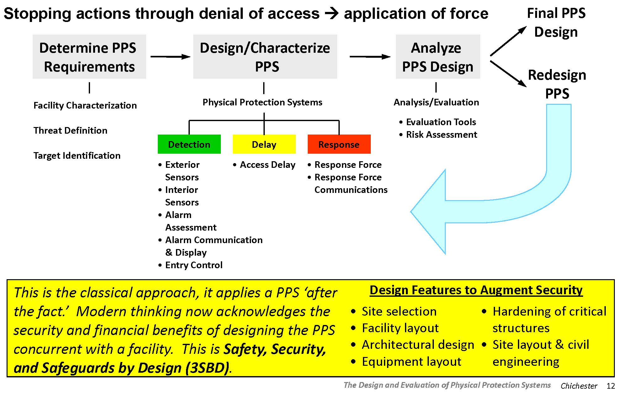
Physical Protection Methodology

Slide 18
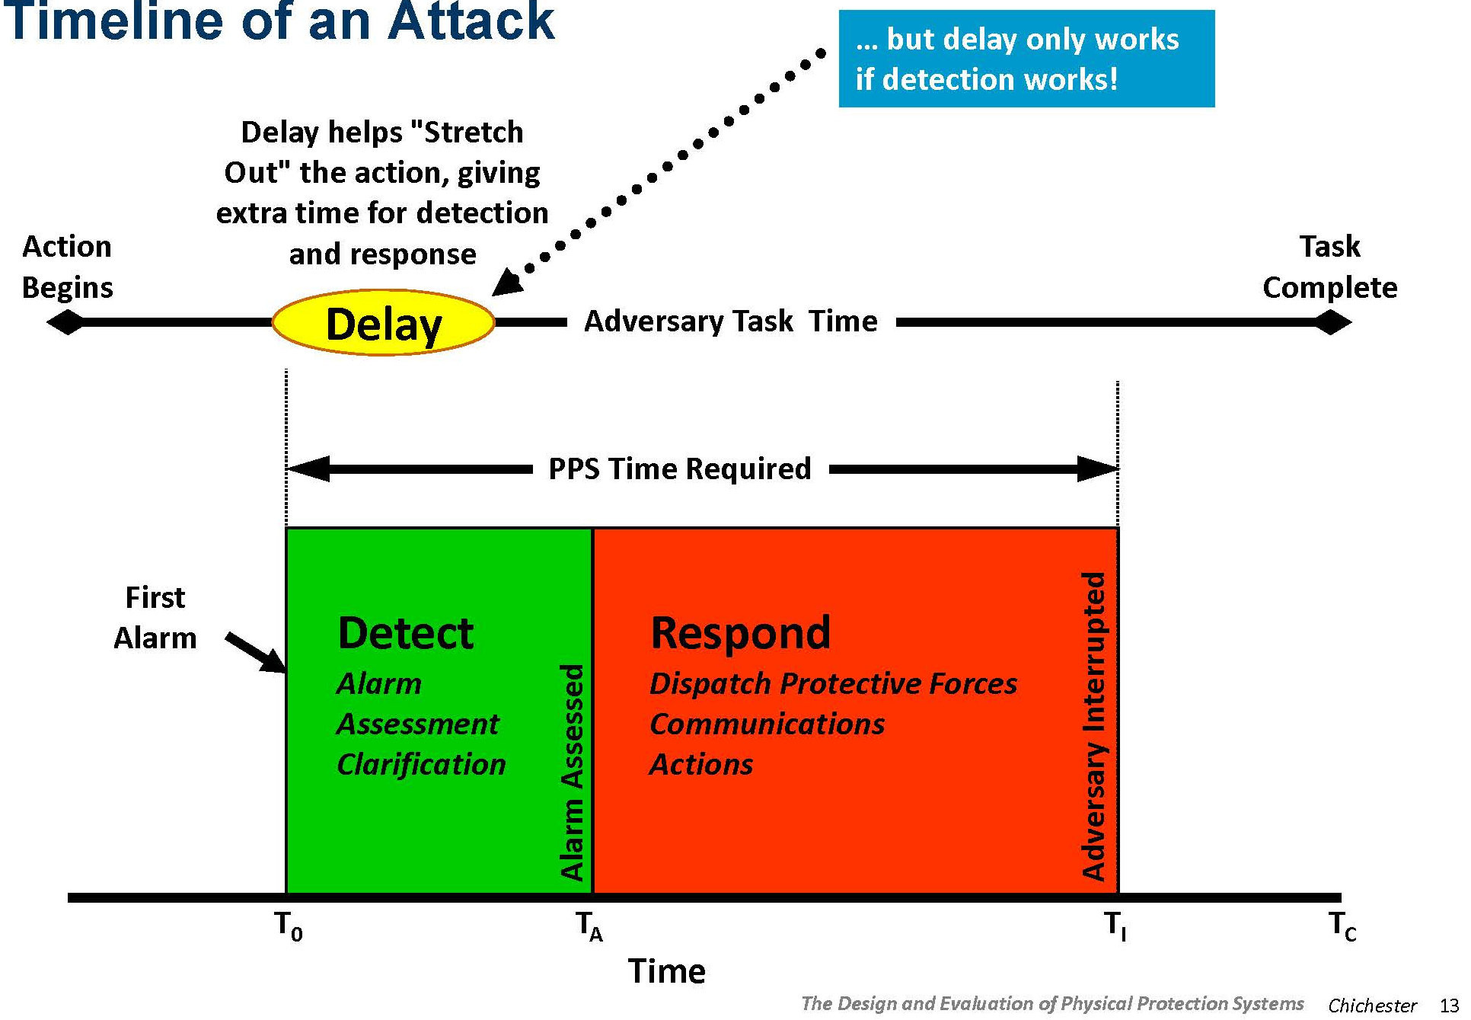
Timeline of an Attack
Notes:
Under what conditions is delay an effective tactic?
Only if detection works!

Slide 19
Material Control
What is material control?
Can you name some types of (physical) controls?
Can you name some different monitoring systems?
Notes:
What is material control?
Material control is the use of control and monitoring measures to prevent or detect loss when it occurs or soon thereafter.
Can you name some types of (physical) controls?
Storage containers, vaults, access gates, key cards, biometrics, guards
Can you name some different monitoring systems?
radiation area monitors, radiation portal monitors, bar code readers, surveillance cameras, physical inspection and inventories, guards

Slide 20
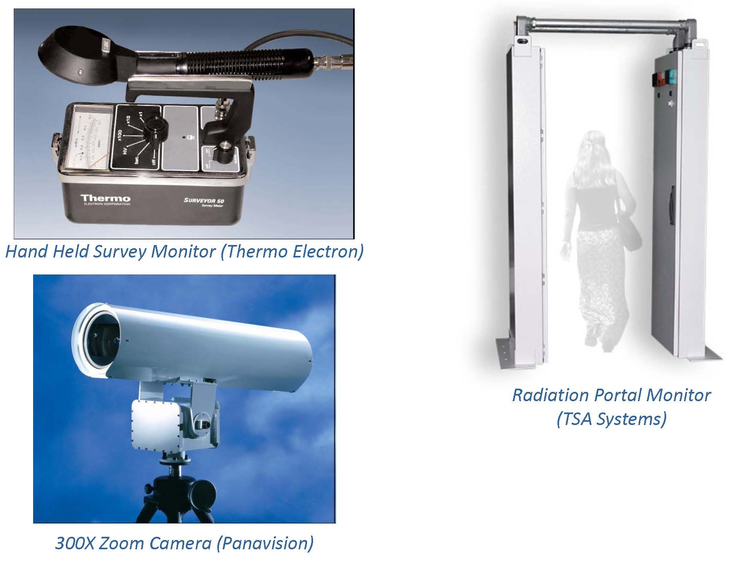
Monitoring

Slide 21
Material Accountancy
What is material accountancy?
Can you describe a “simple approach” to material accountancy?
Can you name and describe the two types of accounting regimes? What are their strengths and weaknesses?
Notes:
What is material accountancy?
The use of statistical and accounting measures to maintain knowledge of the quantities of SNM present in each area of a facility. It includes the use of physical inventories and material balances to verify the presence of material or to detect the loss of material after it occurs, in particular, through theft by one or more insiders.
Can you describe a “simple approach” to material accountancy?
Measure what goes in
Measure what comes out
Account for the difference
Periodically verify inventory to reconcile accounting
Can you name and describe the two types of accounting regimes? What are their strengths and weaknesses?
Item—intact whole items, e.g. reactor fuel elements, sealed cans of materials
Bulk—material in “loose” form, e.g. dissolved Pu concentration in a PUREX plant, hold-up trapped in process piping, 400k pebbles in a PBMR core

Slide 22
Methods of Safeguarding Accountancy
Safeguarding Techniques:
Environmental sampling (ES)—international
Containment and Surveillance (C/S)—domestic & international
Nondestructive Assay (NDA)—domestic and international
Destructive Assay (DA)—domestic and international
Note NDA & DA are key accountancy techniques:
Balancing the books… ...material unaccounted for (MUF)
MUF = BI + I – R – EI
BI = beginning inventory
I = new inputs into a system
R = removals from a system
EI = ending inventory
Notes:
”MUF” is the term used by the IAEA
Note that MUF is ZERO in item counting facilities (or there is a big problem…).
The NRC and DOE use the term inventory difference (ID)

Slide 23
Key Aspects of Accountancy
Accounting practice using Generally Accepted Accounting Principles to track movement and inventory materials
What are Key Measurement Points (KMPs)?
What are Material Balance Areas (MBAs)?
Periodic inventories to determine material quantities
A measurement program using either (or both) NDA and DA techniques
Notes:
Accounting practice using Generally Accepted Accounting Principles to track movement and inventory materials
What are Key Measurement Points (KMPs)?
KMPs are used to determine material flow and inventory
determine / verify material flow, perform inventory measurement
occur at input/outpoint points, storage areas
What are Material Balance Areas (MBAs)?
MBAs are used to enable material accounting and measurement.
Requires a defined area where material inventory can be determined
Transfers into or out of the MBA can be tracked and accounted for
KMPs are often MBA boundaries
Size of the MBA (or, rather, the amount of material within it) should reflect the ability to measure the material inventory and allow for tracking and isolating processes involved in losses

Slide 24
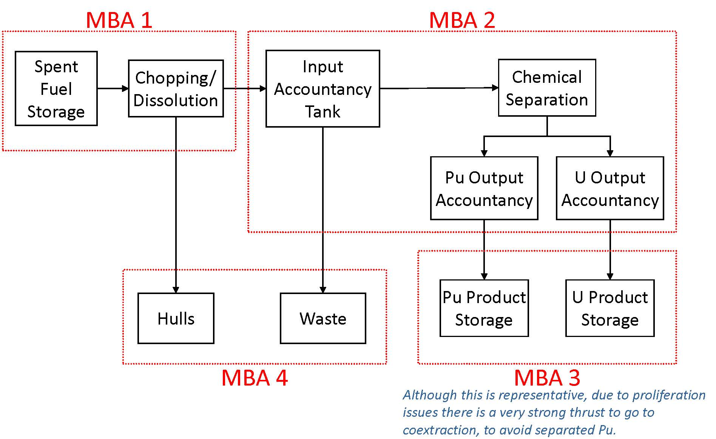
MBA Example—Spent Fuel Reprocessing Facility
Notes:
MBA3 shows storage of separated Pu product and U product, which is often reality. There is a push to go to co-extraction to avoid separated Pu.

Slide 25
International Safeguards
“…the objective of safeguards is the timely detection of diversion of significant quantities of nuclear material from peaceful nuclear activities to the manufacture of nuclear weapons or of other nuclear explosive devices or for purposes unknown, and deterrence of such diversion by the risk of early detection.
To this end the Agreement should provide for the use of material accountancy as a safeguards measure of fundamental importance, with containment and surveillance as important complementary measures.
The Agreement should provide that the technical conclusion of the Agency's verification activities shall be a statement, in respect of each material balance area, of the amount of material unaccounted for over a specific period, giving the limits of accuracy of the amounts stated.
Notes:
Quotes are taken directly from “The Structure and Content of Agreements between the Agency and States Required in Connection with the Treaty on the Non-Proliferation of Nuclear Weapons.” IAEA INFCIRC/153
https://www.iaea.org/sites/default/files/publications/documents/infcircs/1972/infcirc153.pdf
For international safeguards IAEA inspectors carry out the safeguard activities.
The facility owner may or may not be an enthusiastic partner.
Individual measurements are similar to domestic safeguards but the tasks and challenges are very different.

Slide 26
Key Definitions
What is timeline detection?
For metallic Pu and HEU conversion time is estimated at 7-10 days → IAEA detection goal is 1 month
For pure unirradiated compounds of these materials such as oxides or nitrates conversion time is estimated at 1-3 weeks → IAEA detection goal is 3 months
For LEU conversion times is estimated as 1 year → IAEA detection goal is 1 year
What is a significant quantity (SQ)?
For Pu (<80% ²³⁸Pu) the SQ is 8 kg
For ²³³U the SQ is 8 kg
For HEU the SQ is 25 kg of ²³⁵U
For LEU the SQ is 75 kg of ²³⁵U
Notes:
taken from “IAEA Safeguards Monitoring Systems & Science and Technology Challenges for International Safeguards” and “Are IAEA Safeguards on Plutonium Bulk-Handling Facilities Effective?”
What is timeline detection?
The time required to convert different forms of nuclear material to the components of a nuclear explosive device
What is a significant quantity (SQ)?
The approximate quantity of nuclear material in respect of which, taking into account any conversion process involved, the possibility of manufacturing a nuclear explosive device cannot be excluded.

Slide 27
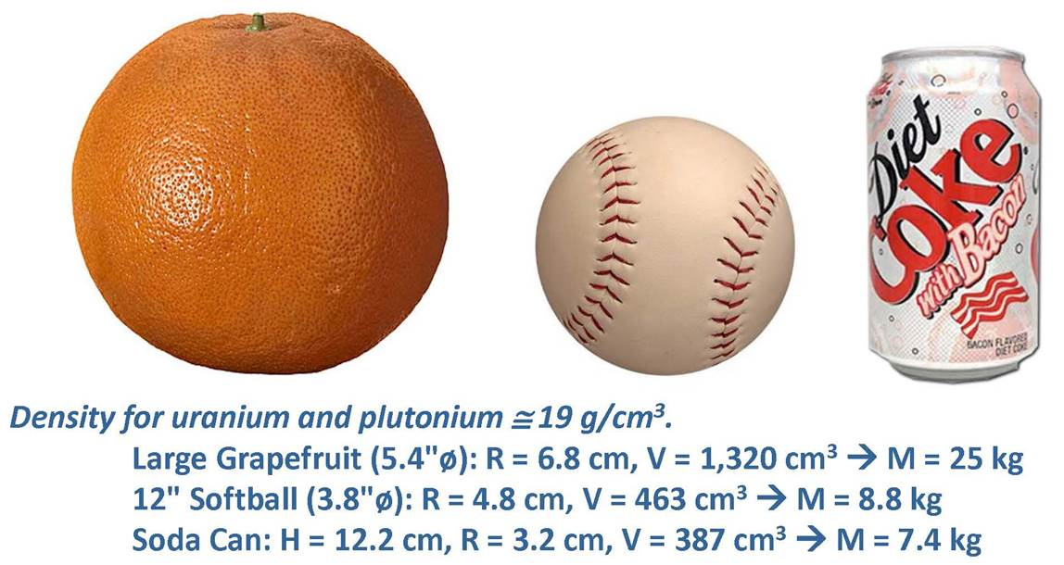
Comparing Sizes
According to the IAEA, 25 kg HEU (about the size of a large grapefruit) or 8 kg of Pu (about the size of a soda can) represent an SQ required to make a crude nuclear weapon.

Slide 28
Implementation
INFCIRC/153—The Structure & Content of Agreements Between the Agency & States in Connection with the NPT
Part I, Paragraph 4: The Agreement should provide that safeguards shall be implemented in a manner designed
To avoid hampering the economic and technological development of the State… …in the field of peaceful nuclear activities, including international exchange of nuclear materials;
To avoid undue interference in the State’s peaceful nuclear activities, and in particular in the operation of facilities; and
To be consistent with prudent management practices required for the economic and safe conduct of nuclear activities
Methods—documentation reviews, open source data collection, IAEA member state contributions, physical inspections with on-site inspectors, unattended monitoring

Slide 29
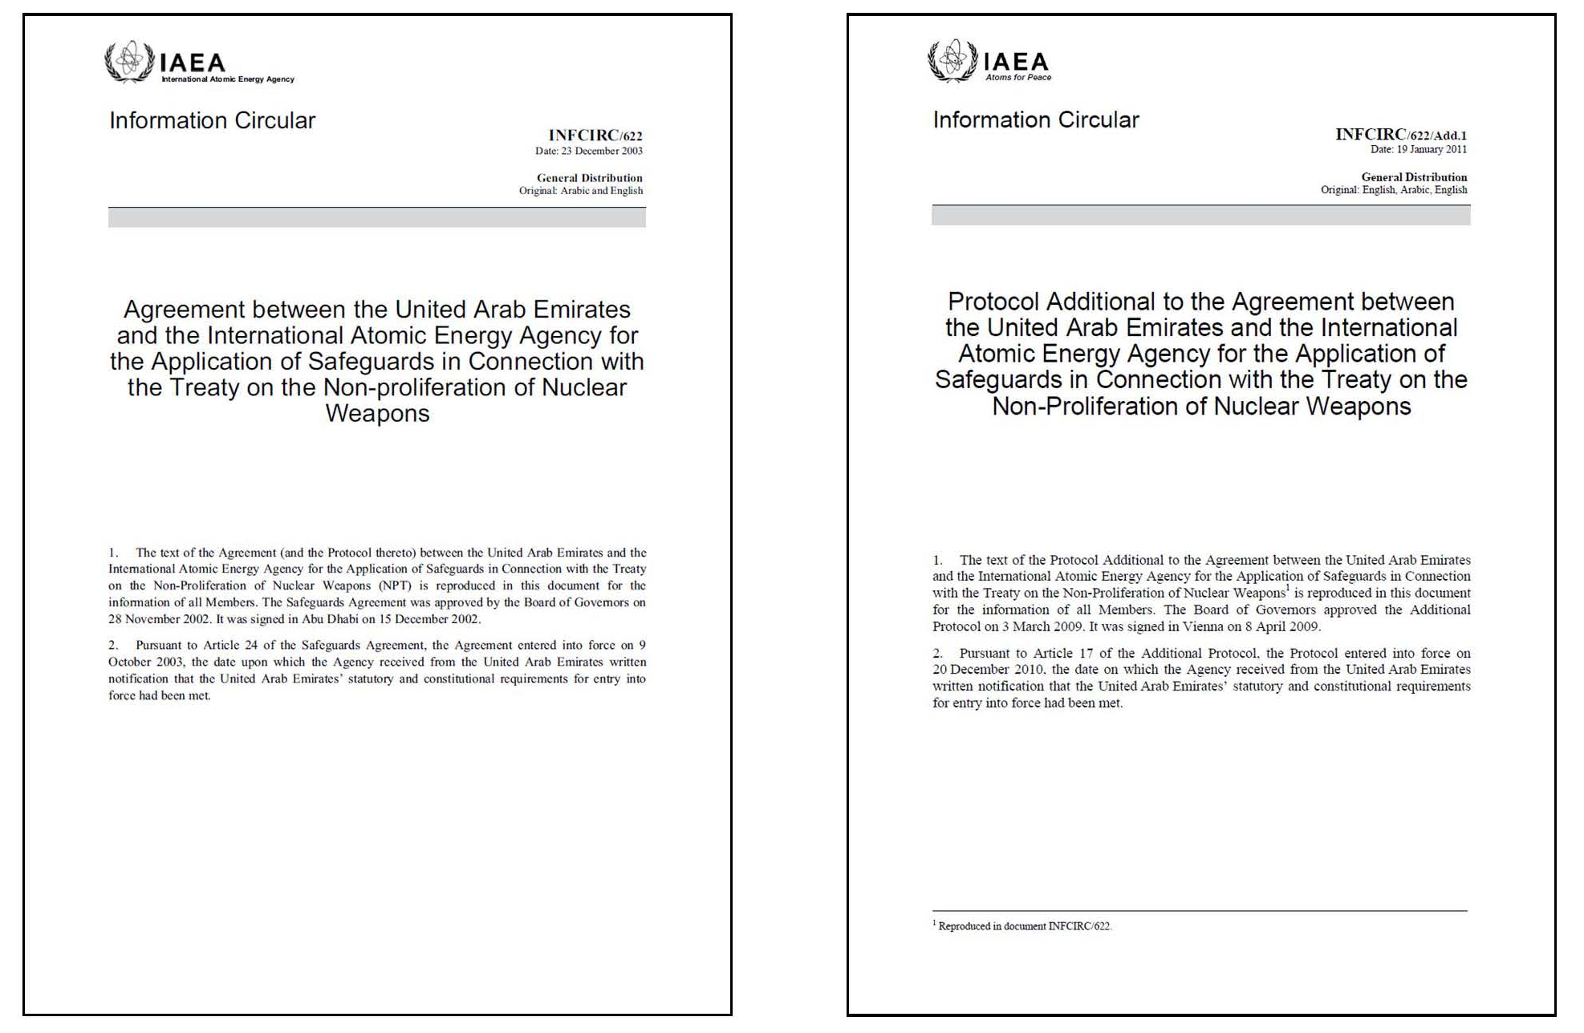
Example: The IAEA and the UAE

Slide 30
When does Safeguards Monitoring Start/End? (UAE Example)
Start: When any nuclear material of a composition and purity suitable for fuel fabrication or for isotopic enrichment leaves the plant or the process stage in which it has been produced, or when such nuclear material, or any other nuclear material produced at a later stage in the nuclear fuel cycle, is imported into the UAE, the nuclear material shall become subject to the other safeguards procedures specified in this Agreement
End: Upon determination that the material has been consumed, or has been diluted in such a way that it is no longer usable for any nuclear activity relevant from the point of view of safeguards, or has become practicably irrecoverable.
Notes:
International Shipments:
Safeguards starts when responsibility ceases to lie with the exporting State, and no later than the time at which the material reaches its destination
Safeguards ends when the recipient State assumes such responsibility, and no later than the time at which the nuclear material reaches its destination.
Safeguards does not apply to material in mining or ore processing activities
Exemptions exist

Slide 31
Key Components to the State Agreement
An inventory of all safeguarded material in country, created by the IAEA.
National system of accounting for and control of nuclear material
Design information for safeguards-related facilities must be provided to the IAEA.
Notes:
An inventory of all safeguarded material in country, created by the IAEA.
National system of accounting for and control of nuclear material
Based on a structure of material balance areas
A measurement system for the determination of the quantities of nuclear material received, produced, shipped, lost or otherwise removed from inventory, and the quantities of inventory
The evaluation of precision and accuracy of measurements and the estimation of measurement uncertainty.
Procedures for identifying, reviewing, and evaluating differences in shipper / receiver measurements—taking a physical inventory—evaluation of accumulations of unmeasured inventory and unmeasured losses.
Design information for safeguards-related facilities must be provided to the IAEA.
Identification of the facility, stating its general character, purpose, nominal capacity, and geographic location
A description of the form, location and flow of nuclear material and the general layout of important items of equipment which use, produce or process nuclear material
A description of features of the facility relating to material accountancy, containment, and surveillance
A description of the existing and proposed procedures at the facility for nuclear material accountancy and control, with special reference to material balance areas established by the operator, measurements of flow, and procedures for taking physical inventory.

Slide 32
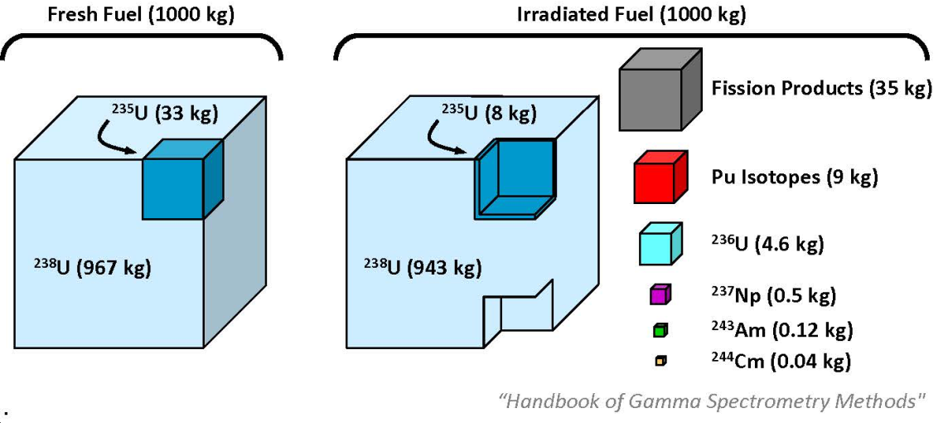
Safeguarding a Nuclear Power Plant
Analysis to monitor diversion pathways and detect undeclared production (one assembly ~ 1 SQ)
Can you name some factors addressed in safeguards analysis?
What are the two main approaches when dealing with reactor material accountancy?
Can you name some other activities the IAEA can / will do?
Notes:
Analysis to monitor diversion pathways and detect undeclared production (one assembly ~ 1 SQ)
Can you name some factors addressed in safeguards analysis?
Measurement methods & techniques available to the Agency
Design features of the facility
Form and accessibility of the nuclear material
Possible existence of unsafeguarded nuclear activities
Inspection experience
What are the two main approaches when dealing with reactor material accountancy?
Item accountancy
Containment and surveillance measures
Name some other activities the IAEA can / will do?
Audit of accounting records and comparison with reports to the Agency
Examination of operating records and reconciliation with accounting records
Verification of fresh fuel before core loading, fuel in the core, and spent fuel pool

Slide 33
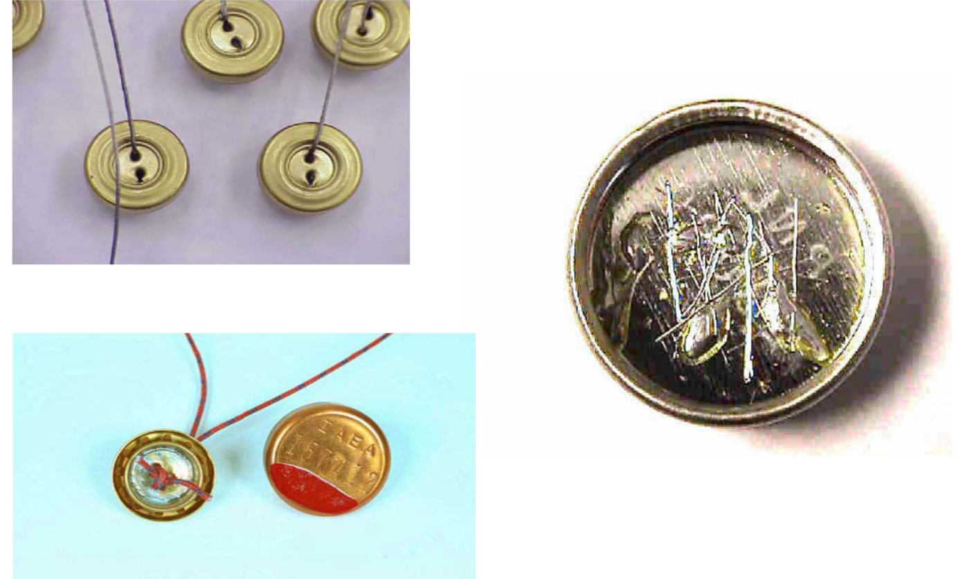
IAEA Metal E-Cap Seals
Notes:
Software is remotely controlled
Use of high reliability and/or redundant critical components
Incorporate independent power systems
Employ multi-layer security systems. Can you name some?
Tamper indicating enclosures
Containment and surveillance on detectors and electronics
Visual inspection of components and cables
Efficiency check with normalization source
Supervision of maintenance
Use of unique data signatures on all digital data
Encrypted data transmission between cabinets and for remote monitoring
Cross correlation with other Safeguards measures

Slide 34
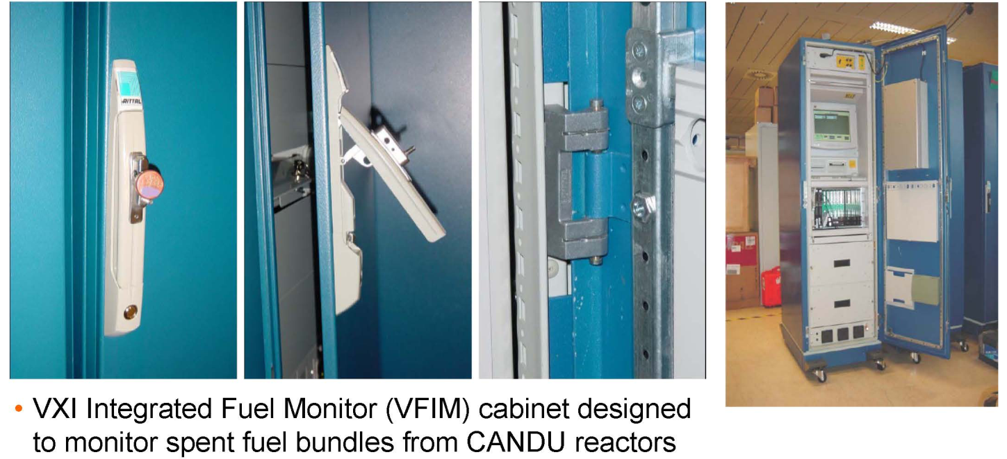
Seals on an Electronics Enclosure

Slide 35
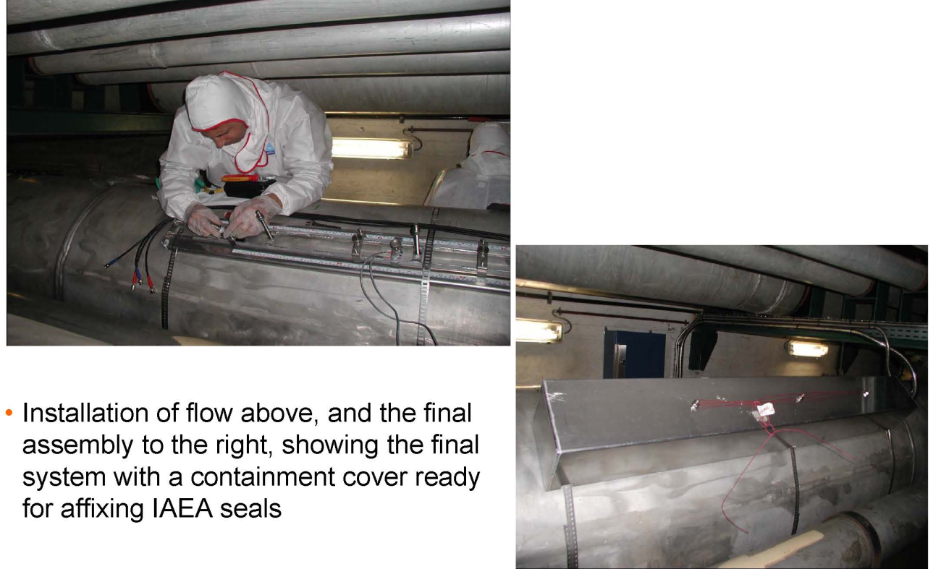
Flow Monitoring

Slide 36
Unattended Monitoring Systems
What are unattended monitoring systems?
What are some of their characteristics?
What are some of the advantages of these systems?
Notes:
What are unattended monitoring systems?
Systems that automatically monitor the flow of nuclear materials 24 hours a day, 365 days a year without the need for human interactoin.
What are some of their characteristics?
Permanently installed in a nuclear facility.
Computer based for data retrieval either on-site or remotely.
May use a variety of sensors such as radiation, pressure, temperature, flow, vibration, and EM fields to collect quantitative or qualitative data.
All external components are in tamper indicating enclosures.
What are some of the advantages of these systems?
They provide the highest level of safeguards assurance through continuous monitoring of activities in nuclear facilities.
They minimize impact on the facility operator by allowing uninterrupted facility operation.
They minimize the impact on the Agency by reducing inspector visits and thereby inspection resources including the high cost of world-wide travel.
They reduce radiation exposure to personnel and can operate in radiation areas too dangerous for humans.

Slide 37
Unattended Monitoring System Installations (circa 2004)
Key Requirements:
Avoid any loss of safeguards significant data
Assure the data is authentic
Key Characteristics:
Use of high reliability and/or redundant critical components
Reduced reliance on low-reliability components
Incorporate independent power systems
Employ multi-layer security systems
Snapshot (circa 2004):
22 countries
44 facilities
90 systems
Notes:
Snapshot (circa 2004):
22 countries
SGOA (SE Asia)—30 systems
SGOB (North and South America, Africa, India, Pakistan, Iran)—40 systems
SGOC (Europe, Kazakhstan, Ukraine)—20 systems
44 facilities
90 systems (+115 mid-2005)
79 radiation based
5 thermo-hydraulic based
6 process monitoring based

Slide 38
Safety, Security, and Safeguards by Design (3SBD)
Approximately 20% of the IAEA’s safeguards inspections (budget) are in support of the Rokkasho and Tokai Reprocessing Plants in Japan.
Do you think that such a large percentage of the IAEA’s effort should be focused on Japan?
What is the concept of 3SBD?
Notes:
Do you think such a large percentage of the IAEA’s efforts should be focused on Japan?
These are the only fuel reprocessing facilities in non-weapon states
$100M at Rokkasho per year.
1200 person days of inspection per year at Rokkasho
In recent years nuclear facility developers have emphasized visualization tools in the design stage to optimize facility access for maintenance, and probabilistic tools for safety analysis, and more recently probabilistic tools for maintenance and security analysis as well.
Building on these concepts, the international consensus is developing to support the idea of a comprehensive appraoch for incorporating all of these concepts into one design philosophy of Safety, Security, and Safeguards by Design (3SD).
These new methods of design seek to:
Ensure design goals are met before construction starts.
Eliminate design cycles and construction phase change orders.
Reduce costs.
Achieve holistic solution to minimize risks and support nonproliferation goals.

Slide 39
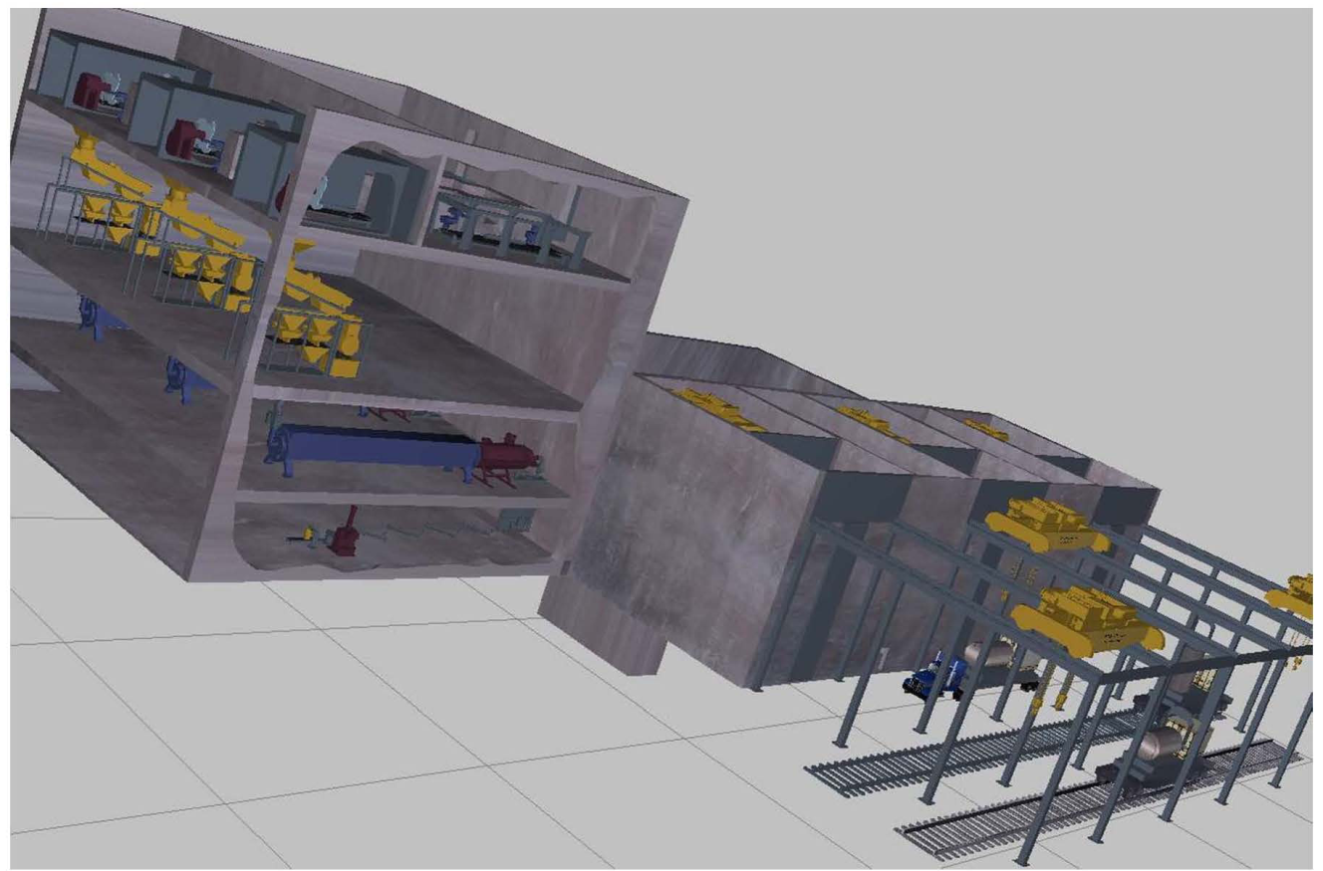
Simulation to Support 3SD and Safeguards Design: A Virtual Reprocessing Facility
Notes:
Do you think such a large percentage of the IAEA’s efforts should be focused on Japan?
These are the only fuel reprocessing facilities in non-weapon states
$100M at Rokkasho per year.
1200 person days of inspection per year at Rokkasho
In recent years nuclear facility developers have emphasized visualization tools in the design stage to optimize facility access for maintenance, and probabilistic tools for safety analysis, and more recently probabilistic tools for maintenance and security analysis as well.
Building on these concepts, the international consensus is developing to support the idea of a comprehensive appraoch for incorporating all of these concepts into one design philosophy of Safety, Security, and Safeguards by Design (3SD).
These new methods of design seek to:
Ensure design goals are met before construction starts.
Eliminate design cycles and construction phase change orders.
Reduce costs.
Achieve holistic solution to minimize risks and support nonproliferation goals.

Slide 40
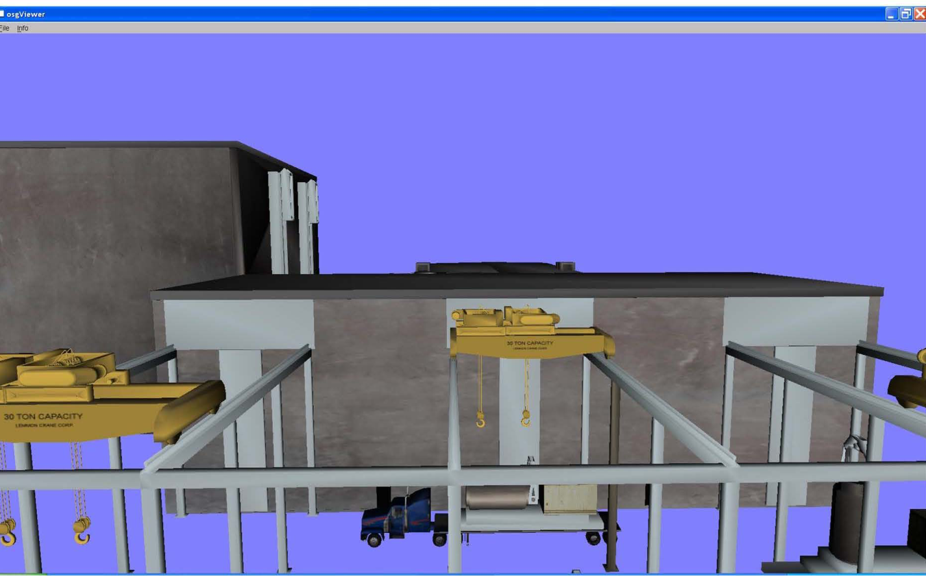
Simulation to Support 3SD and Safeguards Design: Incoming Spent Fuel is Unloaded

Slide 41
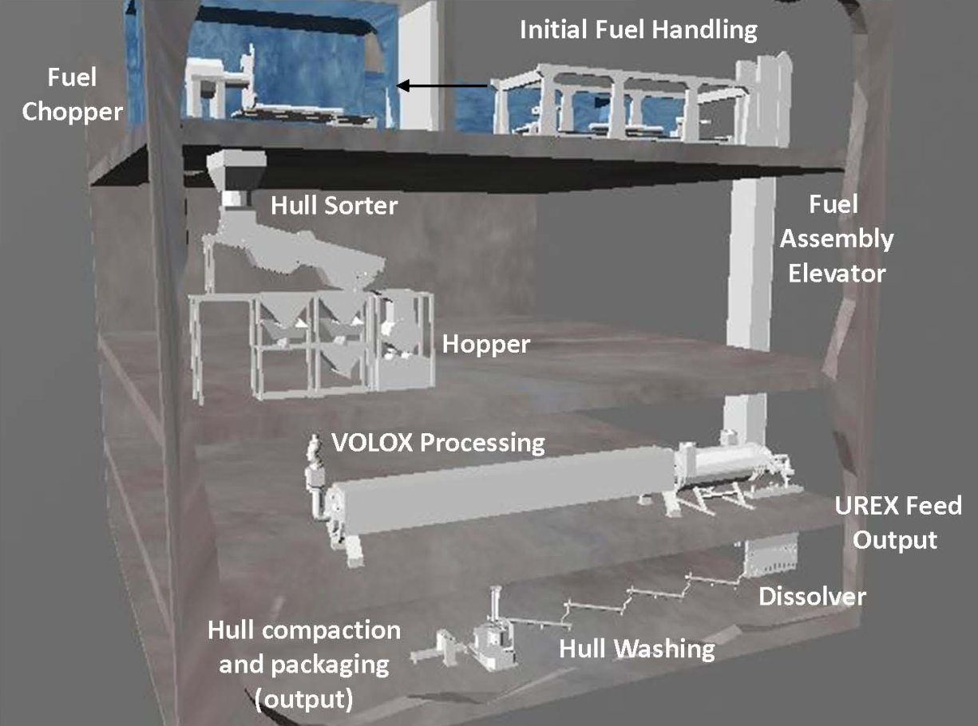
Simulation to Support 3SD and Safeguards Design: Fuel Chopping and Dissolution
Notes:
Model Components:
Facility architecture
Nuclear material accountancy
Material tracking
Safeguards—MBA/KMPs
Physical security systems
Containment and surveillance systems
Process sensors and controls
Impact of radiation fields on radiation sensors and electronic components
Process engineering

Slide 42
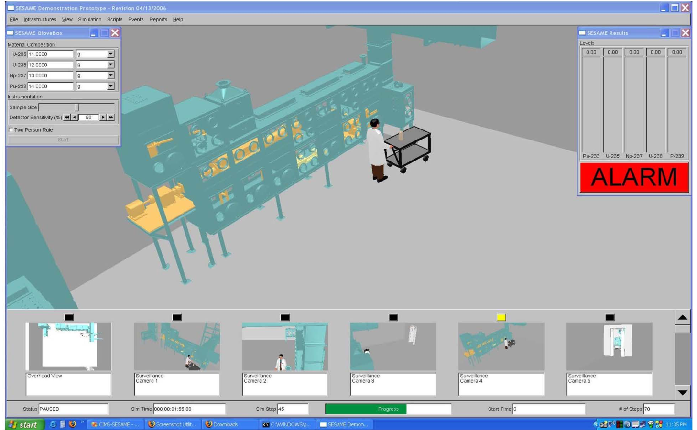
Another Facility Simulation: Gloveboxes
Notes:
Placement of physical security systems—surveillance cameras

Slide 43
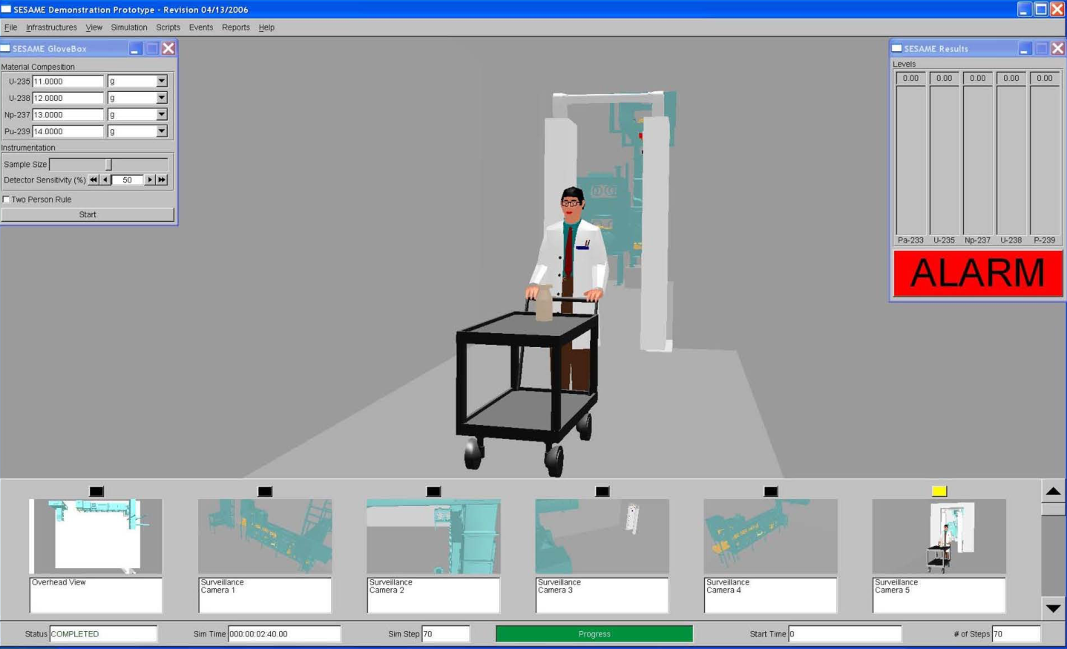
Another Facility Simulation: Gloveboxes
Notes:
Surveillance cameras and radiation portal alarms

Slide 44
Summary
Safeguards, nonproliferation, and arms control are all inherently linked activities
Domestic safeguards
The host supports and implements the safeguard activities
Terrorism, sabotage, and insider threats are the key challenges
Focus on physical protection, material control, and material accontancy
International Safeguards
The IAEA implements safeguards activities
The host may or may not support the safeguards activities
The primary “concern” is the host nation, with immense resources and capabilities
Adversarial situations can arise
Strong focus on seals, cameras, unattended monitoring, and on-site inspectors
MPC&A plays a strong role but the challenges are very different
3SD
Ensure safety, security, and safeguard goals are met
Reduce cost
Reduce project risk

Slide 45
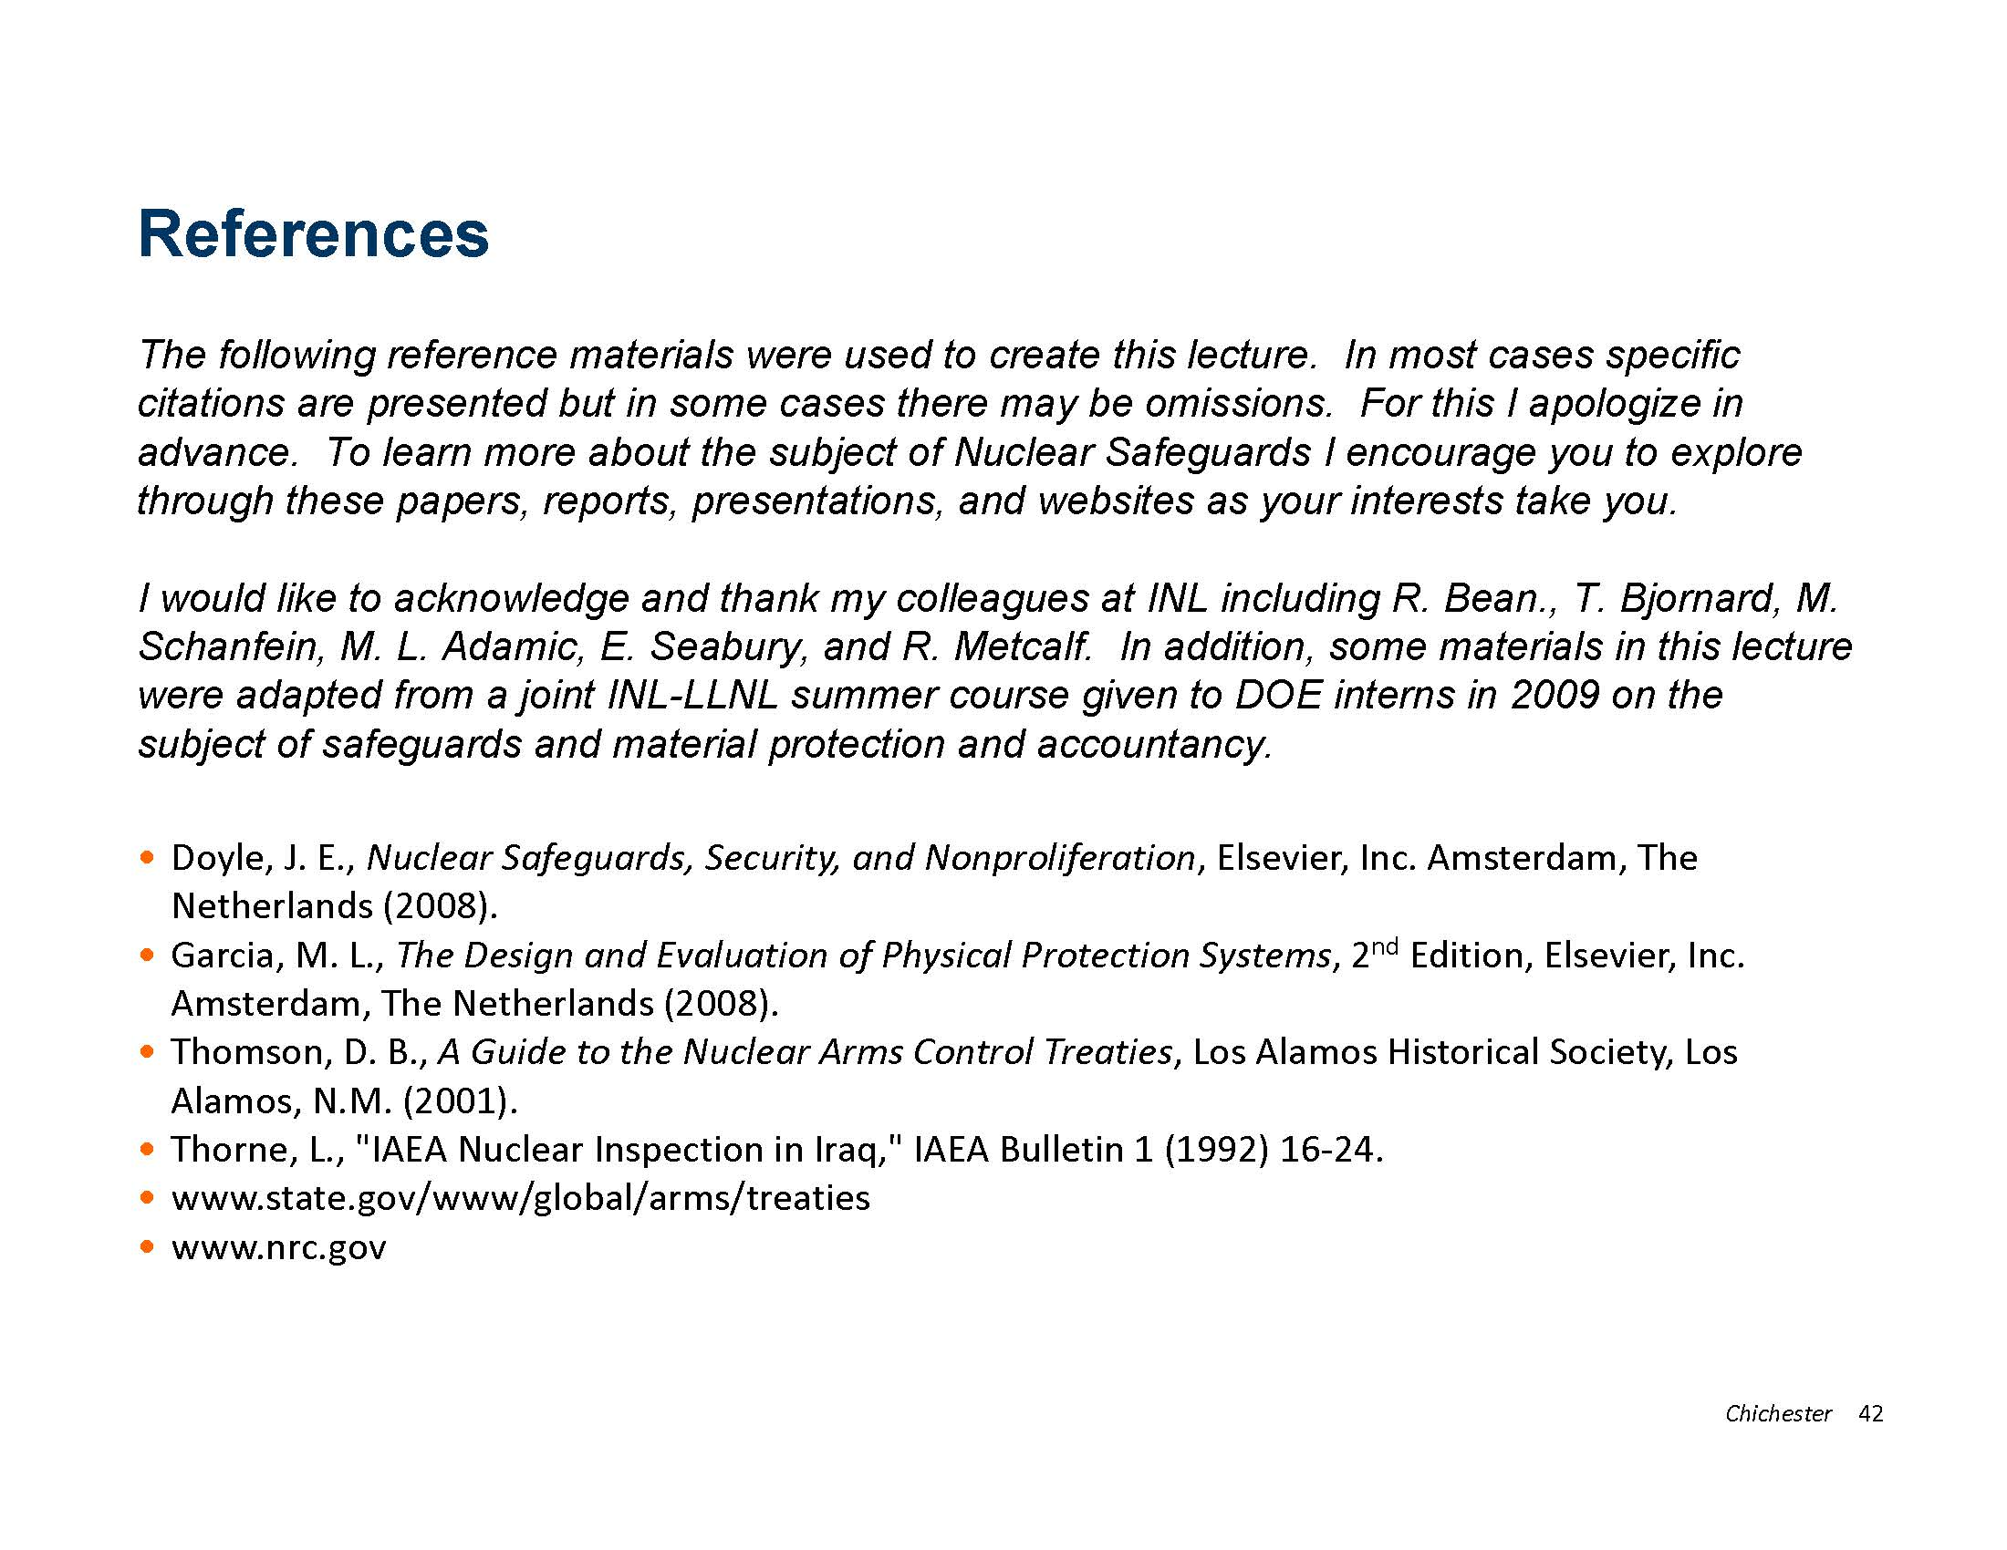

Slide 46
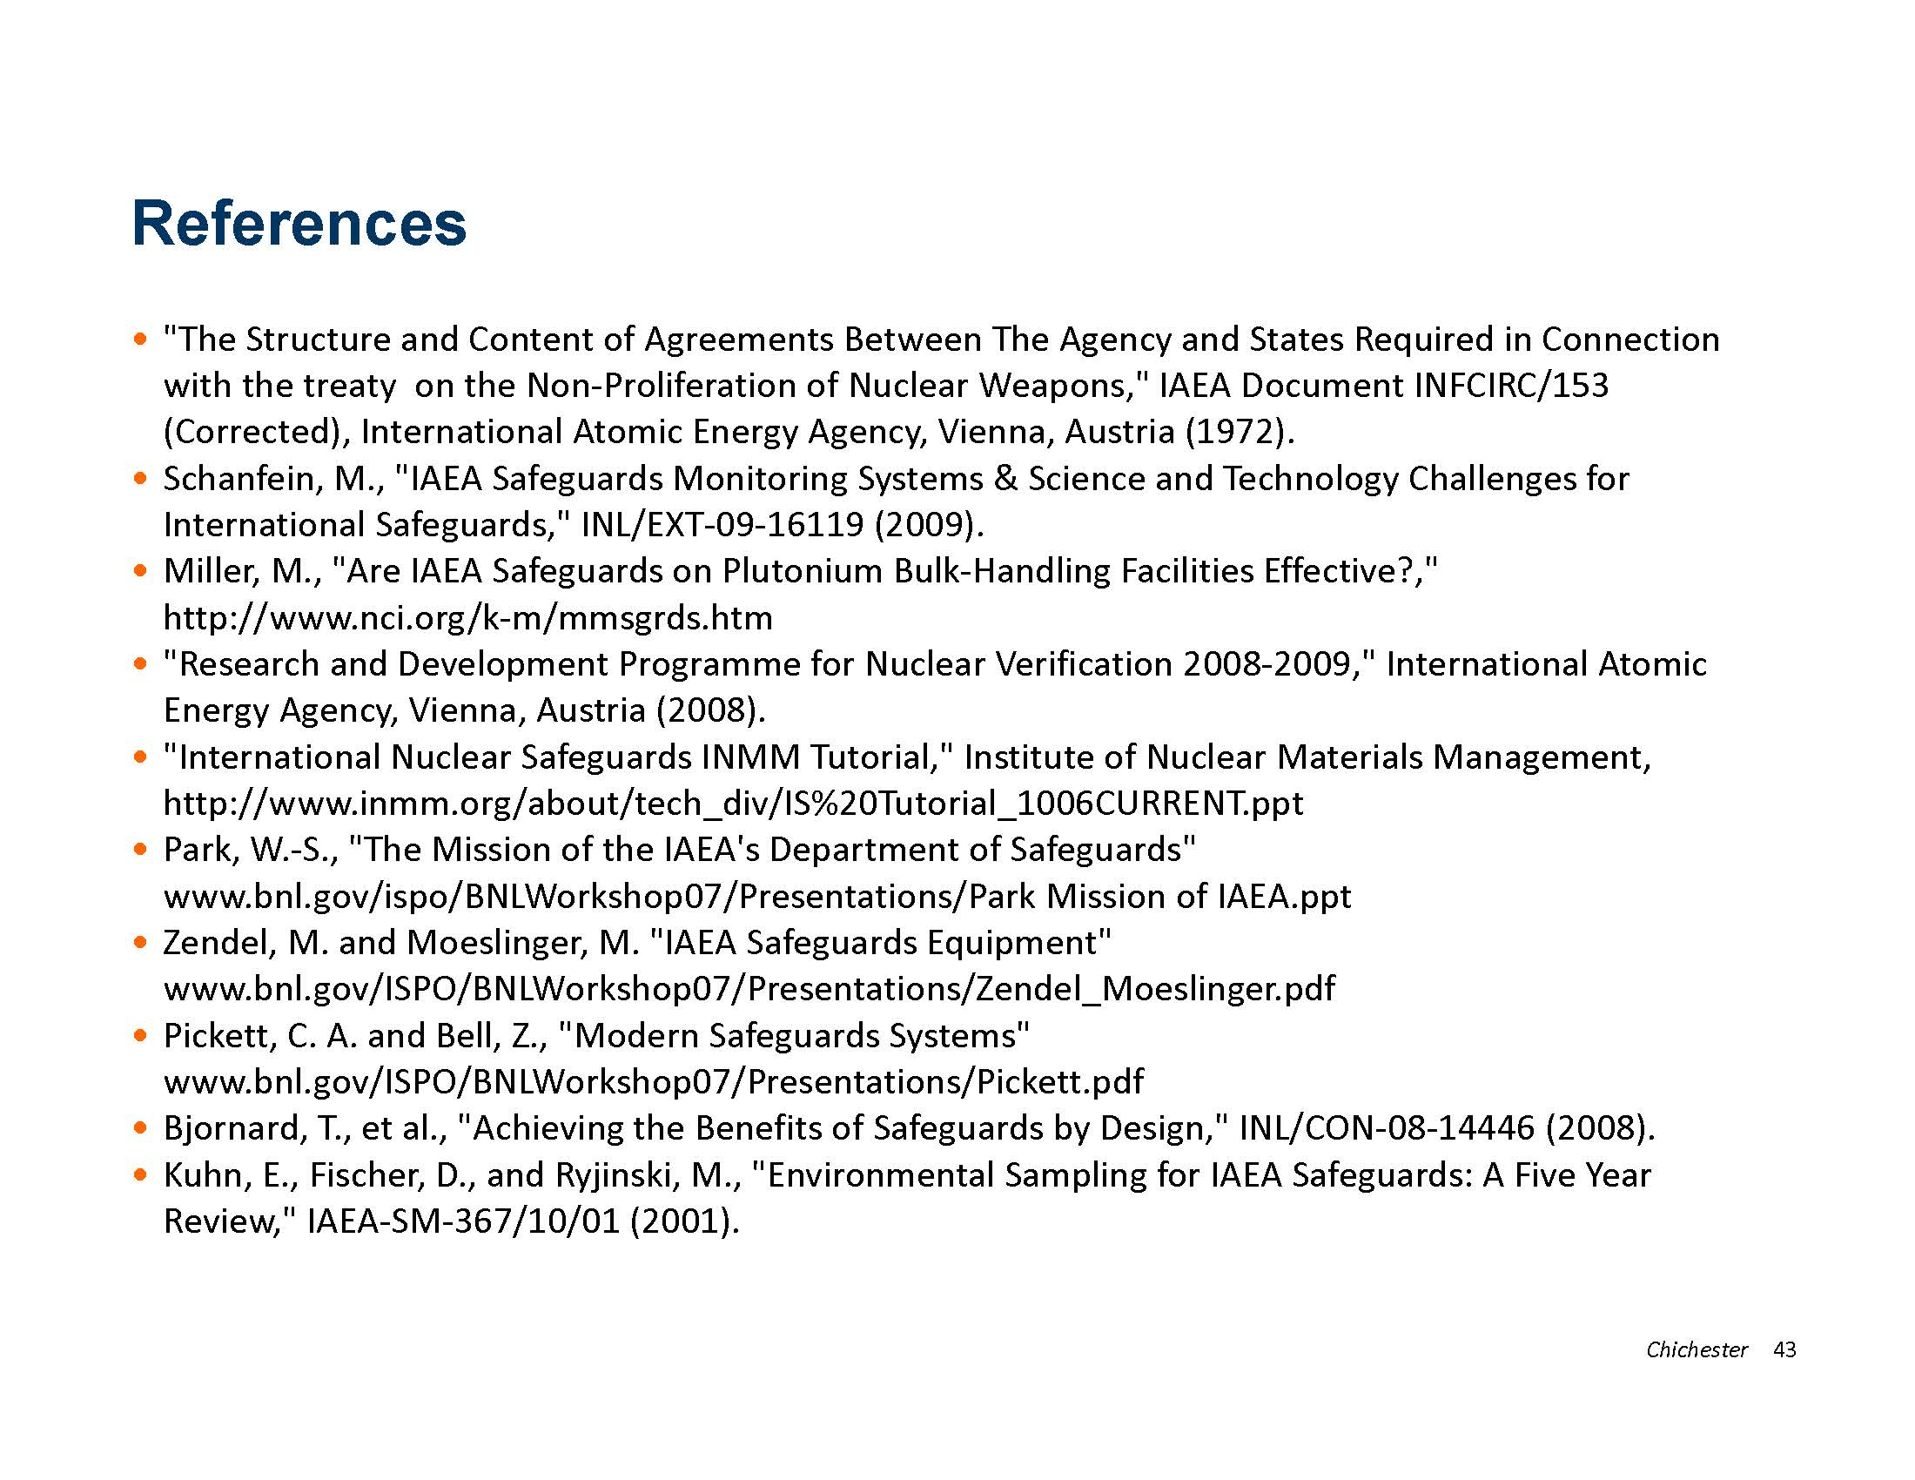

Slide 47
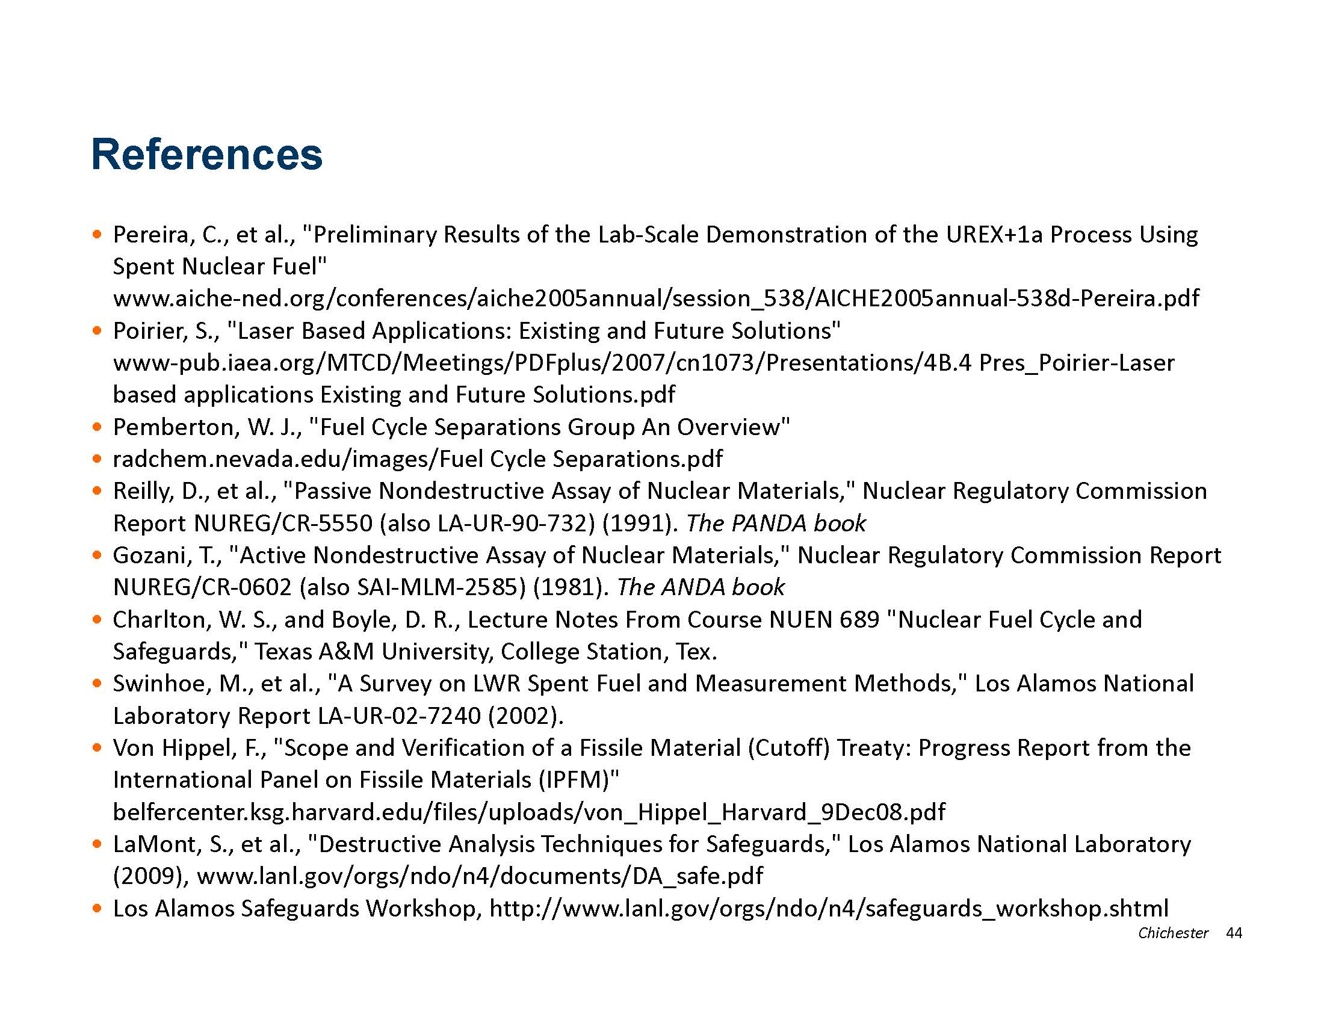

Slide 48
